Slide 1
OPTIMAL CONTROL OF VARIABLE SPEED WIND TURBINES
KISHORE
AAKASH
THENMOZHI
PRIYANKA

Slide 2
Objective
To increase the performance of optimal control and to maintain the power of the wind turbine when it is operating above the rated speed of wind turbine using LQR Controller.

Slide 3
Two Types of Wind Turbine
Horizontal Axis : A horizontal axis machine has its blades rotating on an axis parallel to the ground
Vertical Axis: A vertical axis machine has its blades rotating on an axis perpendicular to the ground.

Slide 4
Why not vertical axis wind turbine?
1 At higher elevations it is not possible to get high wind speed above the ground .
2 Therefore the output of the power is less.

Slide 5
3 High cost of the vertical wind turbine 4 No ease of installation 5 High noise production

Slide 6
What is LQR and Why it is used here?
Operating a dynamic system at minimum cost where System dynamics are defined by linear differential equations.
In this system, LQR is used because it manages to reduce the loads even under the turbulent conditions.

Slide 7
Also rigorous control of design is ensured along with the trade-off between energy efficiency and reliability. But this is not possible in case Of PI and PID controller.

Slide 8
Wind speed versus power 1 Initially, in below rated speed the output power increases linearly. 2 Then in above rated speed, we make use of pitch angle and electromagnetic torque as a control variables to reduce the structured loads there by maintaining the output power constant at a rated speed of 14m/s.

Slide 9
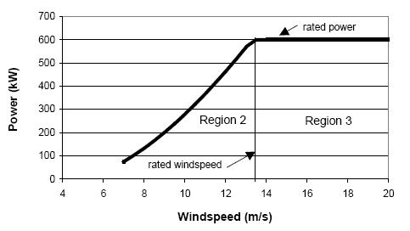
Wind speed versus power

Slide 10
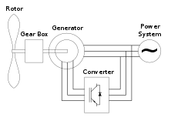
Mechanical Structure of the wind turbine

Slide 11
Block scheme of the controlled system:

Slide 12
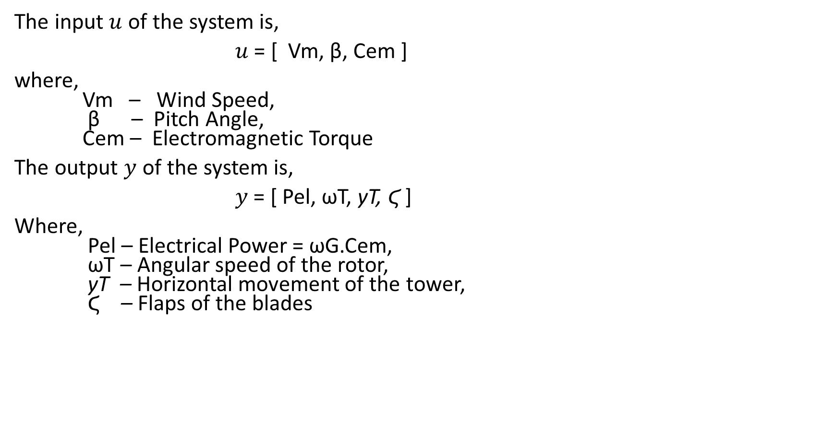
The input $u$ of the system is,
$u$ = [ Vm, β, Cem ]
where, Vm – Wind Speed, β – Pitch Angle, Cem – Electromagnetic Torque
The output $y$ of the system is,
$y$ = [ Pel, ωT, yT, Ϛ ]
Where, Pel – Electrical Power = ωG.Cem, ωT – Angular speed of the rotor, yT – Horizontal movement of the tower, Ϛ – Flaps of the blades

Slide 13
The state vector is given by,
Where,
qT – angular position of the rotor
qG – angular position of the generator
Ϛ – flap of the blades
yT – horizontal movement of the tower
ωT – angular speed of the rotor
ωG – angular speed of the generator
β – pitch angle
Vm – velocity of wind
xT = (qT − qG, z, yT, ωT, ωG, Ϛ, yT, β, Vm)T

Slide 14
Angular speed calculation,
Angular speed of the rotor,
Angular speed of the generator,
Where , Power coefficient, Cp = power_wind/(0.5*row*pi*(Dia/2)^2*V^3*0.95*0.95
ωT = (60*V*TSR)/(pi*Dia)
ωG = (Diameter/2)*((Cp*row*pi*(Dia/2)^2*V^3)/41)^0.5

Slide 15
State Space Model:
The state space model of 12x12 wind turbines have been estimated and among those wind turbines, we have chosen the optimal 1x1 wind turbine and the transfer function of that particular 1x1 wind turbine has been calculated.
The state space model of the optimal wind turbine is given by,

Slide 16
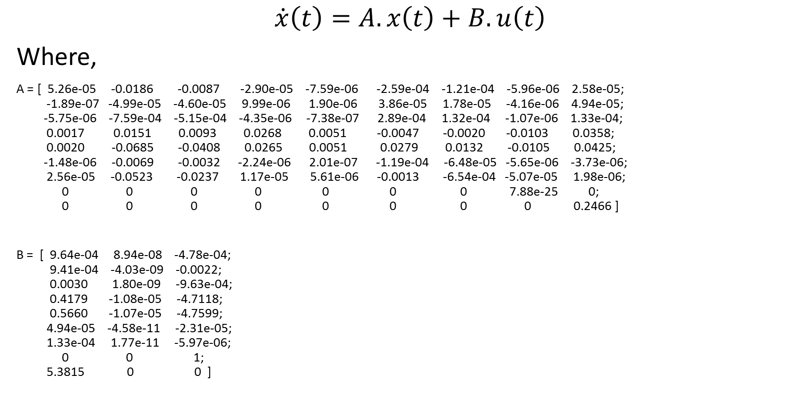
$$\dot{x}\left(t\right)=A. x\left(t\right)+B. u\left(t\right)$$
Where,
A = [ 5.26e-05 -0.0186 -0.0087 -2.90e-05 -7.59e-06 -2.59e-04 -1.21e-04 -5.96e-06 2.58e-05; -1.89e-07 -4.99e-05 -4.60e-05 9.99e-06 1.90e-06 3.86e-05 1.78e-05 -4.16e-06 4.94e-05; -5.75e-06 -7.59e-04 -5.15e-04 -4.35e-06 -7.38e-07 2.89e-04 1.32e-04 -1.07e-06 1.33e-04; 0.0017 0.0151 0.0093 0.0268 0.0051 -0.0047 -0.0020 -0.0103 0.0358; 0.0020 -0.0685 -0.0408 0.0265 0.0051 0.0279 0.0132 -0.0105 0.0425; -1.48e-06 -0.0069 -0.0032 -2.24e-06 2.01e-07 -1.19e-04 -6.48e-05 -5.65e-06 -3.73e-06; 2.56e-05 -0.0523 -0.0237 1.17e-05 5.61e-06 -0.0013 -6.54e-04 -5.07e-05 1.98e-06; 0 0 0 0 0 0 0 7.88e-25 0; 0 0 0 0 0 0 0 0 0.2466 ]
B = [ 9.64e-04 8.94e-08 -4.78e-04; 9.41e-04 -4.03e-09 -0.0022; 0.0030 1.80e-09 -9.63e-04; 0.4179 -1.08e-05 -4.7118; 0.5660 -1.07e-05 -4.7599; 4.94e-05 -4.58e-11 -2.31e-05; 1.33e-04 1.77e-11 -5.97e-06; 0 0 1; 5.3815 0 0 ]

Slide 17

$$y\left(t\right)=C. x\left(t\right)+D.u\left(t\right)$$
Where,
C = [ 0 0 0 1 0 0 0 0 0; 0 0 0 50 0.25 0 0 0 0; 0 0 1 0 0 0 0 0 0; 0 1 0 0 0 0 0 0 0 ]
D = [ 0 0 1e-05; 0 0 0; 0 0 0; 0 0 0 ]

Slide 18
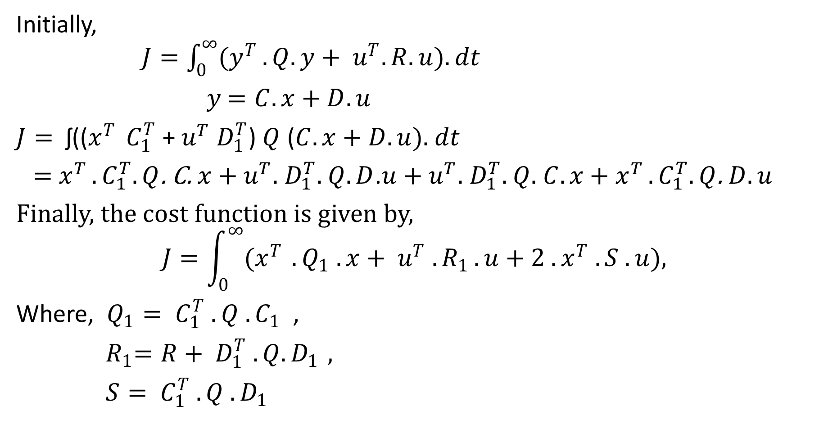
Cost Function:
Initially, $J=\int_{0}^{∞}{(y^{T}}. Q. y+ u^{T}. R. u). dt$
$y$ $=C. x+D.u$
$J=$ ʃ(($x^{T }$ $C_{1}^{T}$ + $u^{T}$ $D_{1}^{T}$) $Q$ ($C. x+D.u$). $dt$
= $x^{T }.C_{1}^{T}.Q$. C. $x$ + $u^{T}.$ $D_{1}^{T}.$ $Q.D$.$u$ + $u^{T}.$ $D_{1}^{T}.$ $Q.$ $C. x$ + $x^{T }.C_{1}^{T}.Q$. $D.u$
Finally, the cost function is given by,
$$J=\int_{0}^{∞}{(x^{T }}. Q_{1} . x+ u^{T} . R_{1 }. u+2 . x^{T} . S . u),$$
Where, $Q_{1}= C_{1}^{T} . Q . C_{1}$ ,
${ R}_{1}=R+ D_{1}^{T} . Q. D_{1 },$
$S= C_{1}^{T} . Q . D_{1}$

Slide 19
Advantages:
Optimal Cost
Load reduction
Reducing the needed materials
Good quality energy delivered

Slide 20
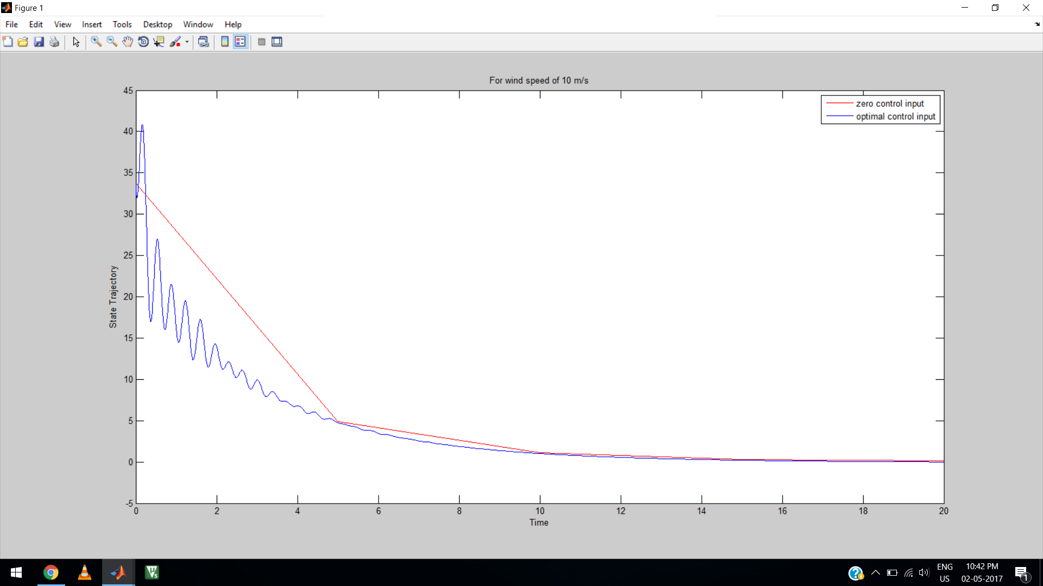
Result:
Here the operating point for the linearization corresponds to the wind speed value of 15m/s .

Slide 21
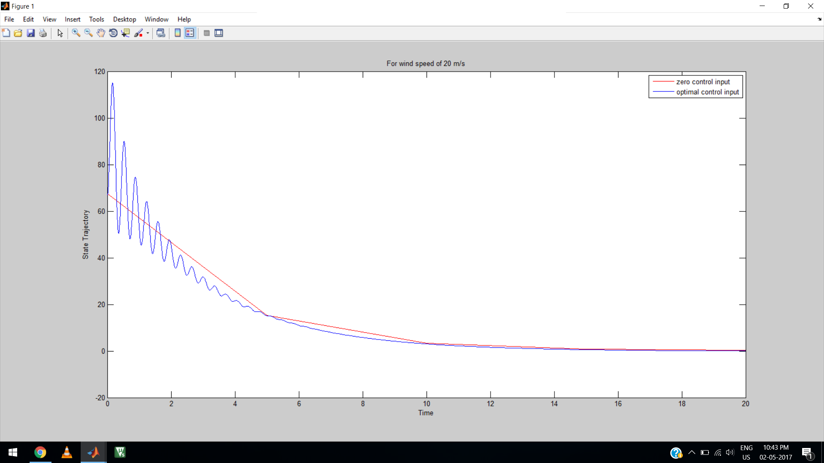

Slide 22
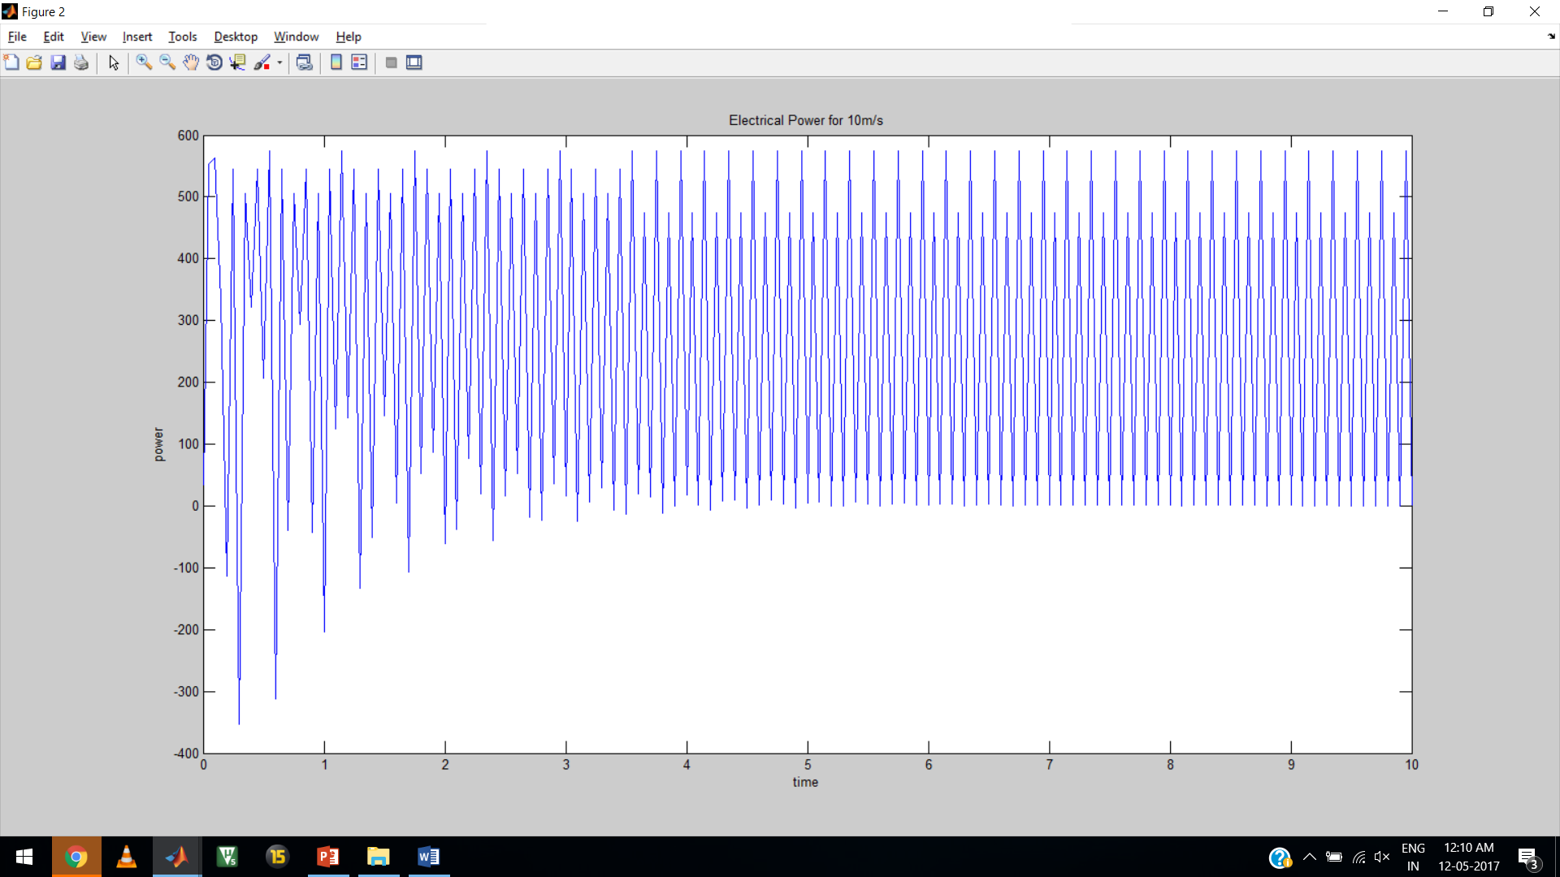

Slide 23
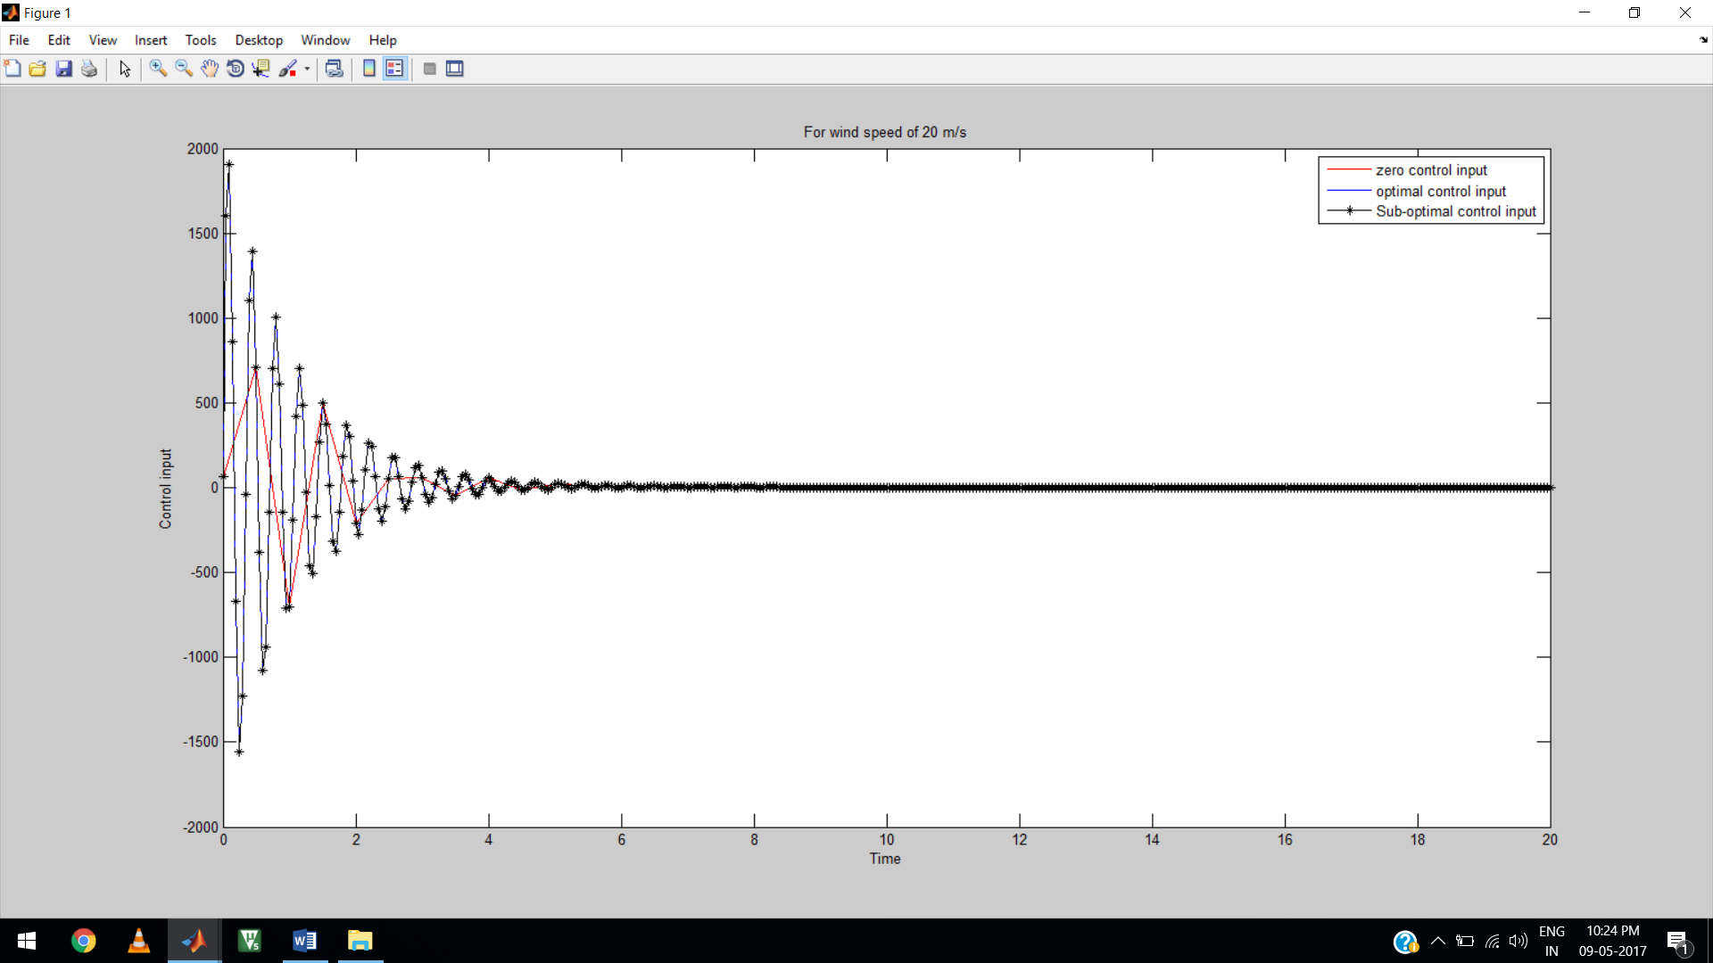

Slide 24
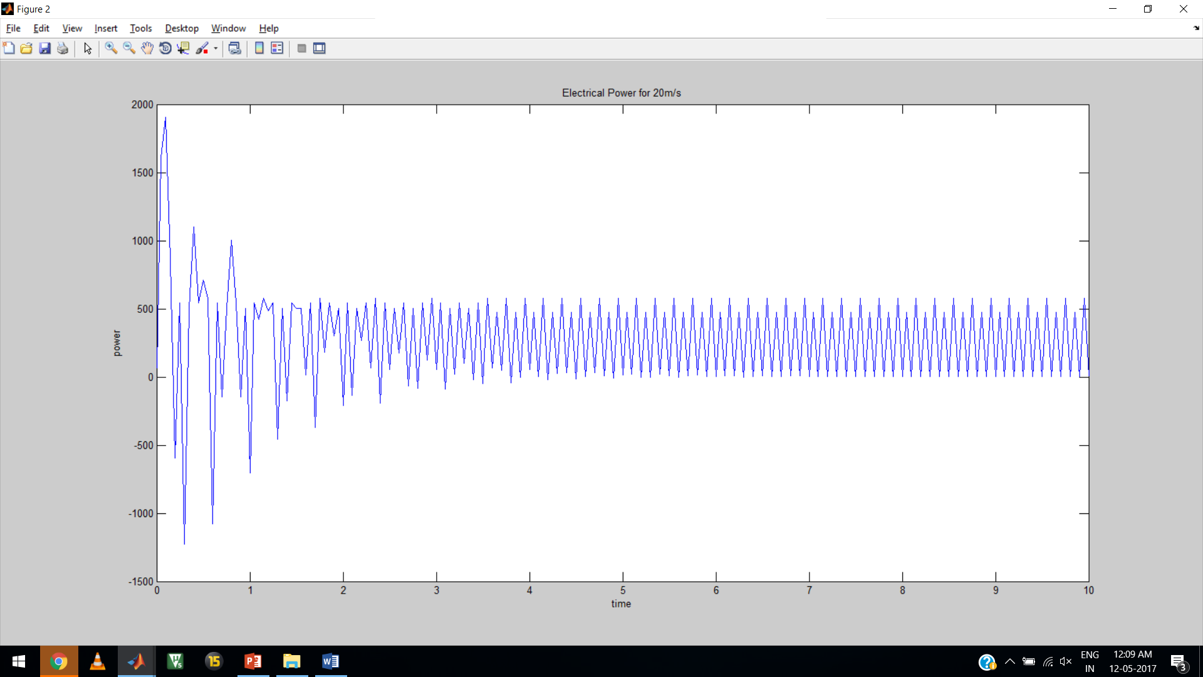

Slide 25
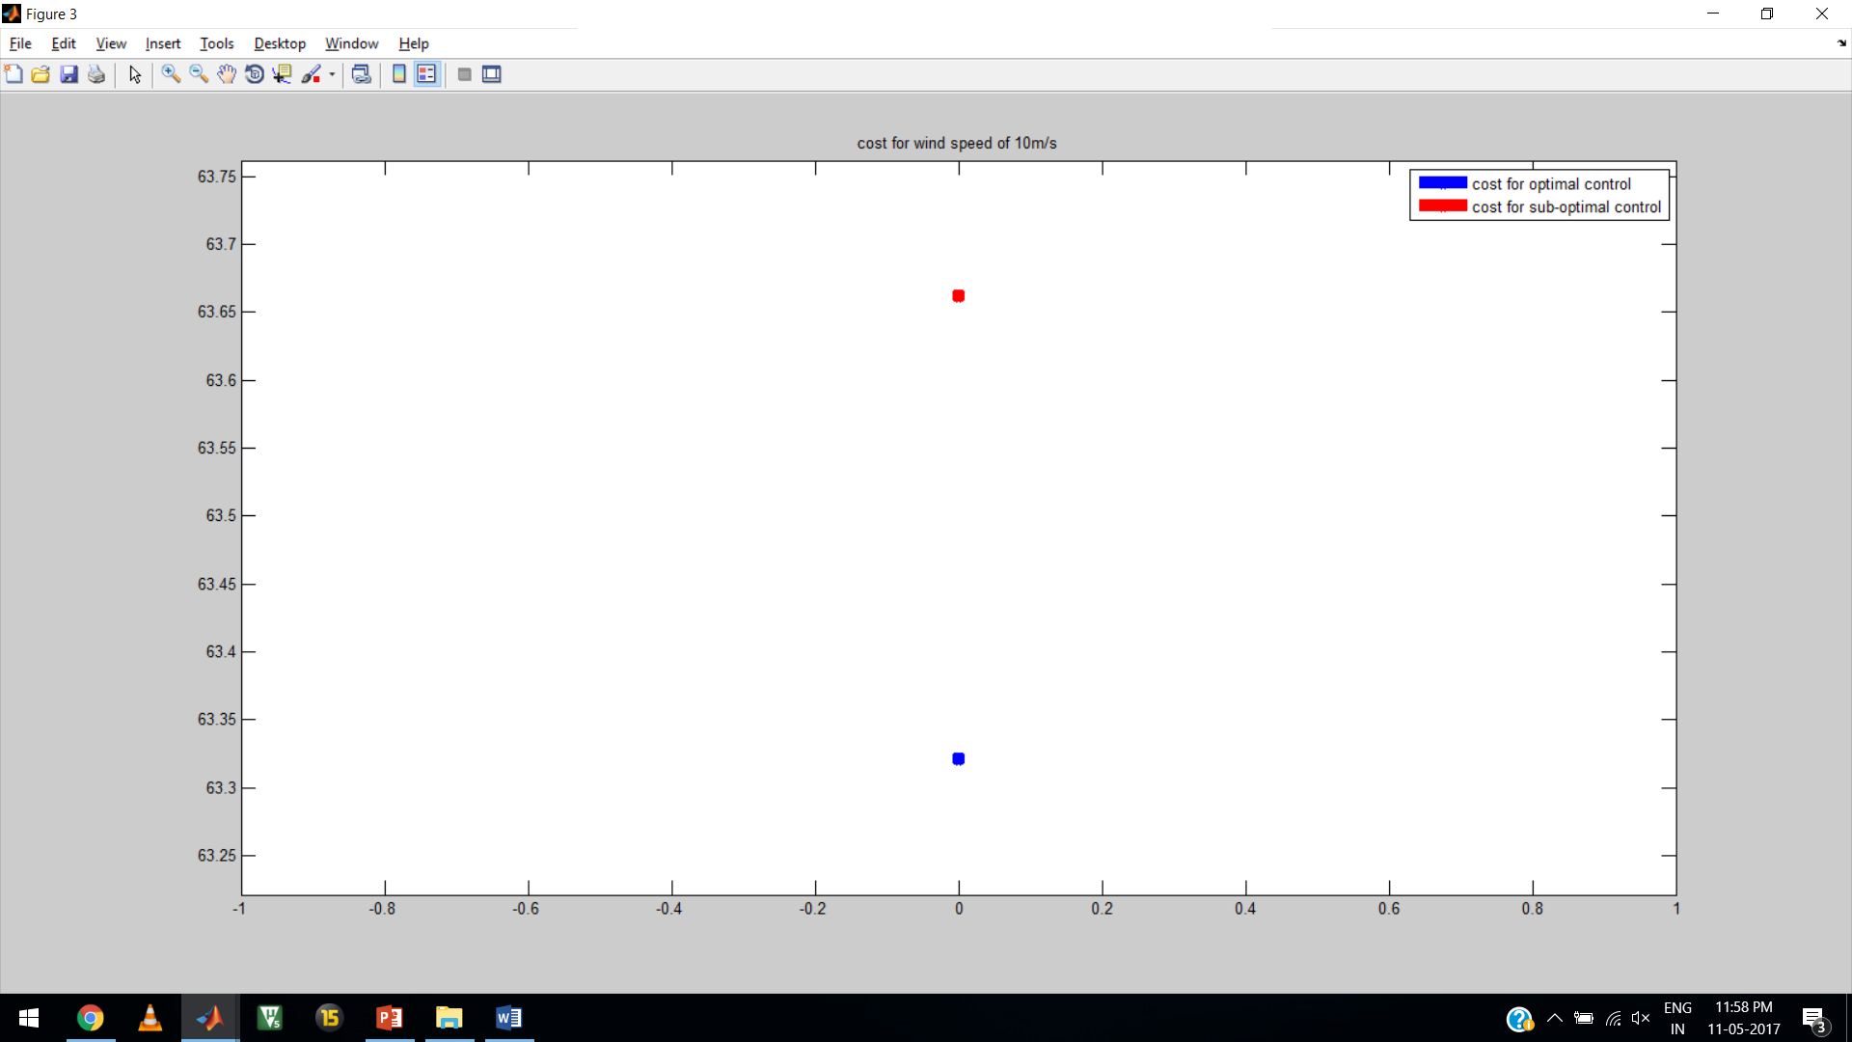

Slide 26
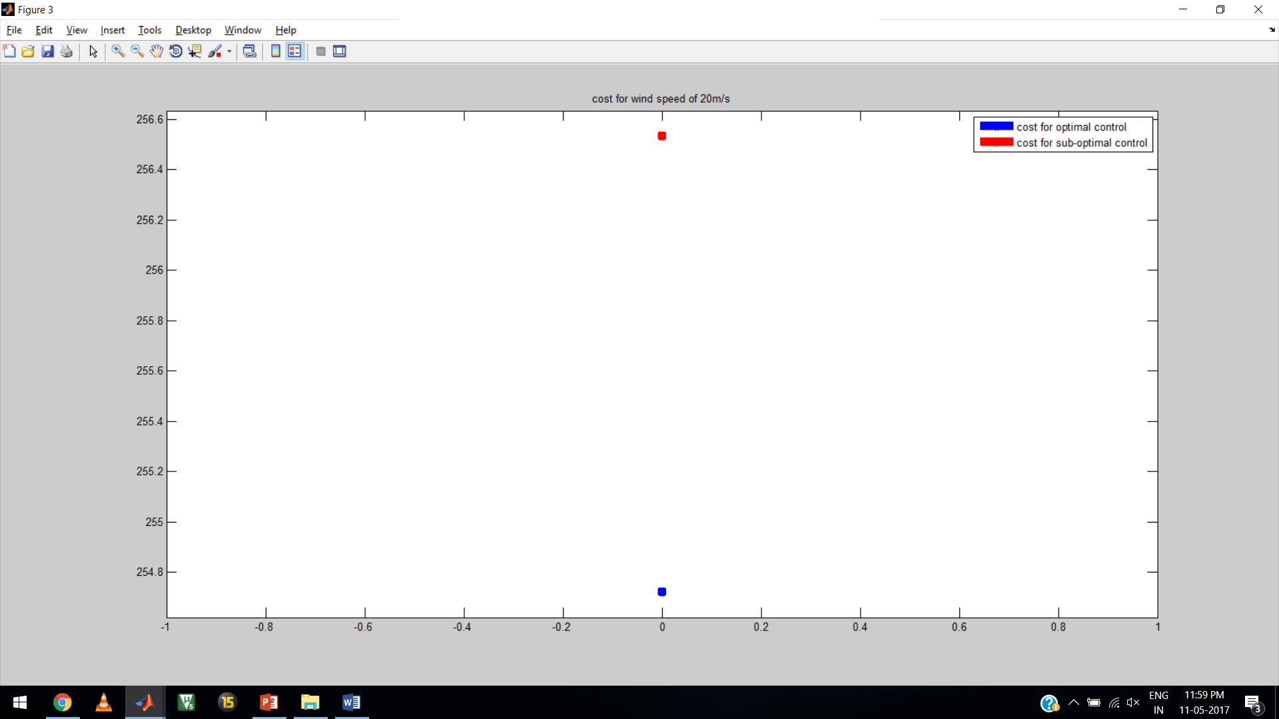

Slide 27
Conclusion:
The simulations were done using MATLAB software and the results proved good performances.
The system is controllable and it does not contain unobservable modes.
The result plots shows that the constant power is produced for all wind speeds.

